Slide 1
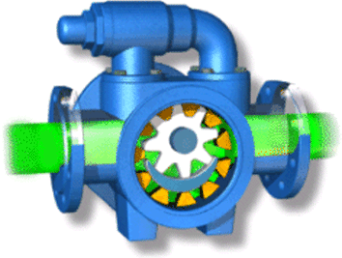
Core 1
Core k
Core n
Task 0
Task k
Task n
…
……
…
……
…
Task i
Task k+i
Task n+i
abort or continue
abort or continue
abort or continue
Utilization
new kernel call
External Task Pools
Global
Task Pools
full
……
empty
balance kernel
Global
Task Pools
full
……
empty

